Slide 1

MadData 2023
Safer Roads Initiative
Presented By:
Ahnaf Abrar Kabir
Steven Haworth
Xinyu Zhou
Yuwei Tang

Slide 2
MOTIVATION

Slide 3


Chicago Data Portal
Owned and updated by Chicago Police Department
700,000 rows of Data
49 Columns of Traffic Crash Information
Our challenges: What did we need for our product?
Size of file ← Git Issues, Slow Kernels, Non Transferable Data
Cleaning it ← Some Poorly Formatted Dates & Columns
Machine Learning models ← Applying ML Models
Merging with front end ← Avoid conflicts, minimizing errors and maintaining functionality

Slide 4
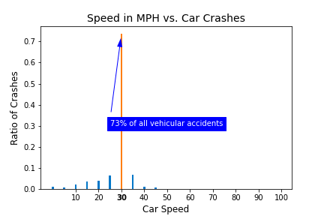
Modeling Chicago Vehicular Crashes
Speed vs Crashes
Based on percentage
50-100 mph provided very little data
Do you see an outlier?
Is this data what you expected?

Slide 5
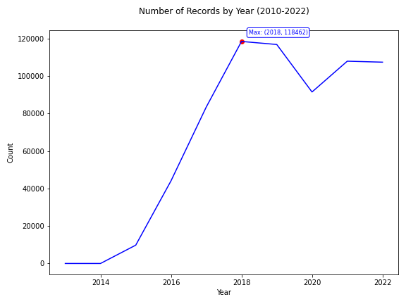
Modeling Chicago Vehicular Crashes
Number of Crashes per Year
Increase in vehicle accidents from 2015
118,462 Traffic Related Accidents (2018, 118462)
Notice a 2020 Dip
All data visualization using MATPLOTLIB

Slide 6
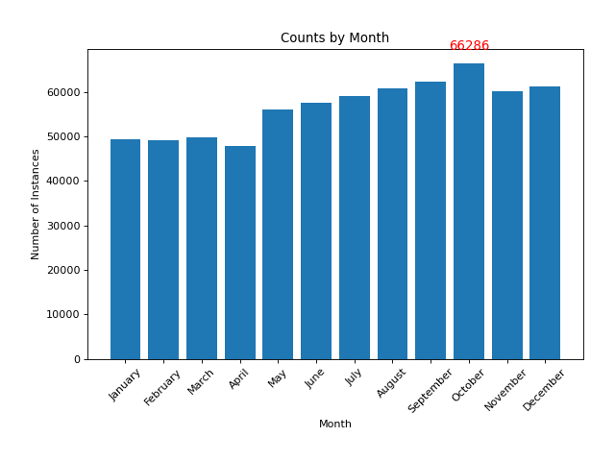
Weekday Graph Include
Crashes by Month
October most dangerous month
66,286 traffic crashes
2016-2022 observed more wet conditions
All data plotted using MATPLOTLIB

Slide 7
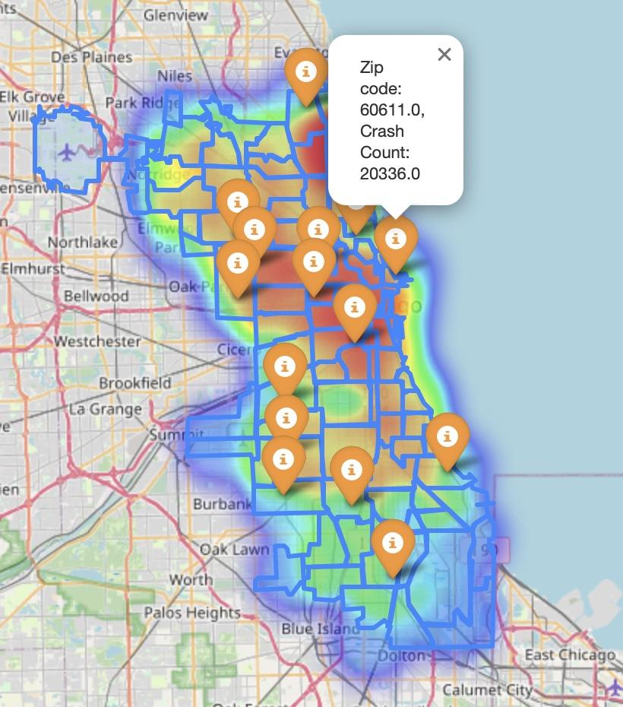
CRASH OCCURRENCE HEAT MAP
Density of Accidents
K means clustering
Imperative to understand hotspots
More red, higher density!

Slide 8
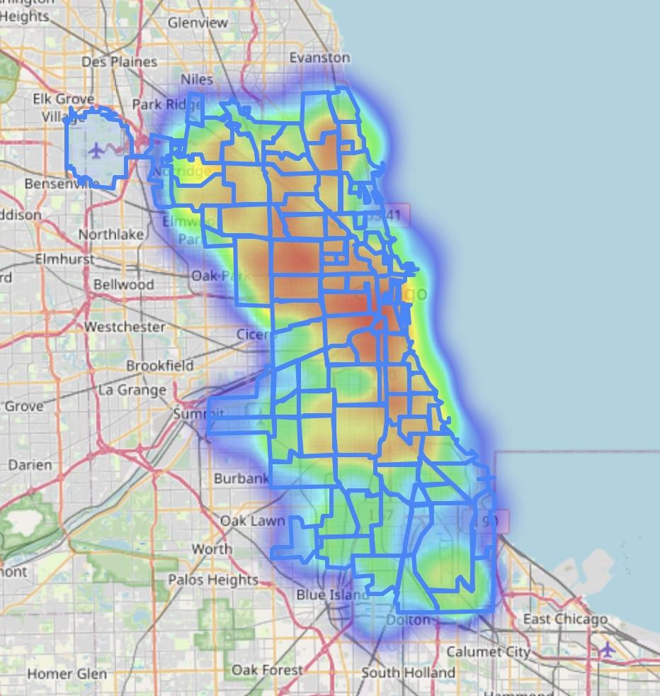
IDENTIFYING CRITICAL POINTS
Most Costly Accidents
Random Forest Classification
Imperative to understand hotspots
Most costly accidents in red

Slide 9
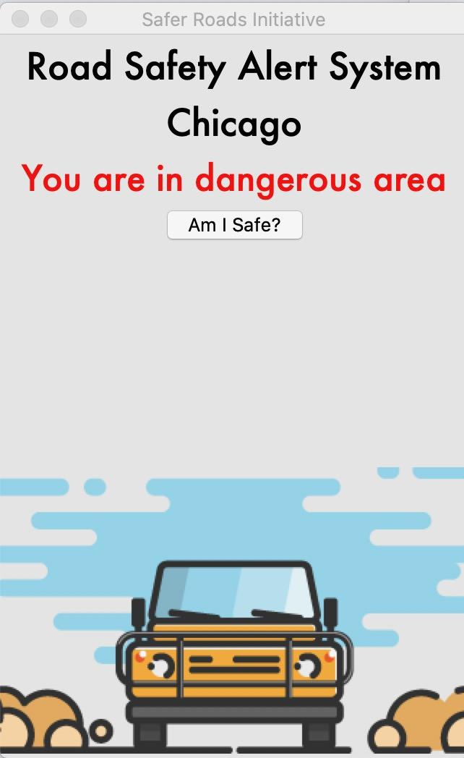
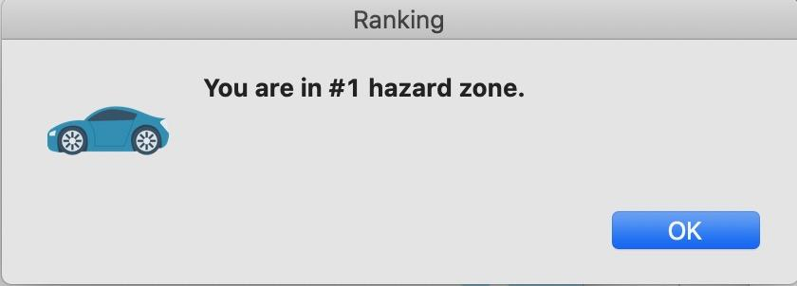
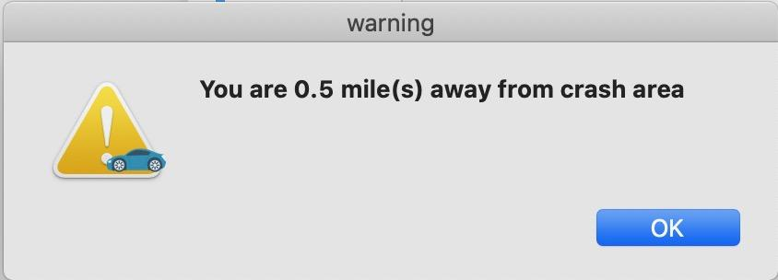
Chicago Road Safety Alert System
Provide user with live safety information
Uses multivariate analysis to identify hazardous conditions.
Noticeable, yet undistracting
Alert the user within 1 mile of a hazard zone

Slide 10
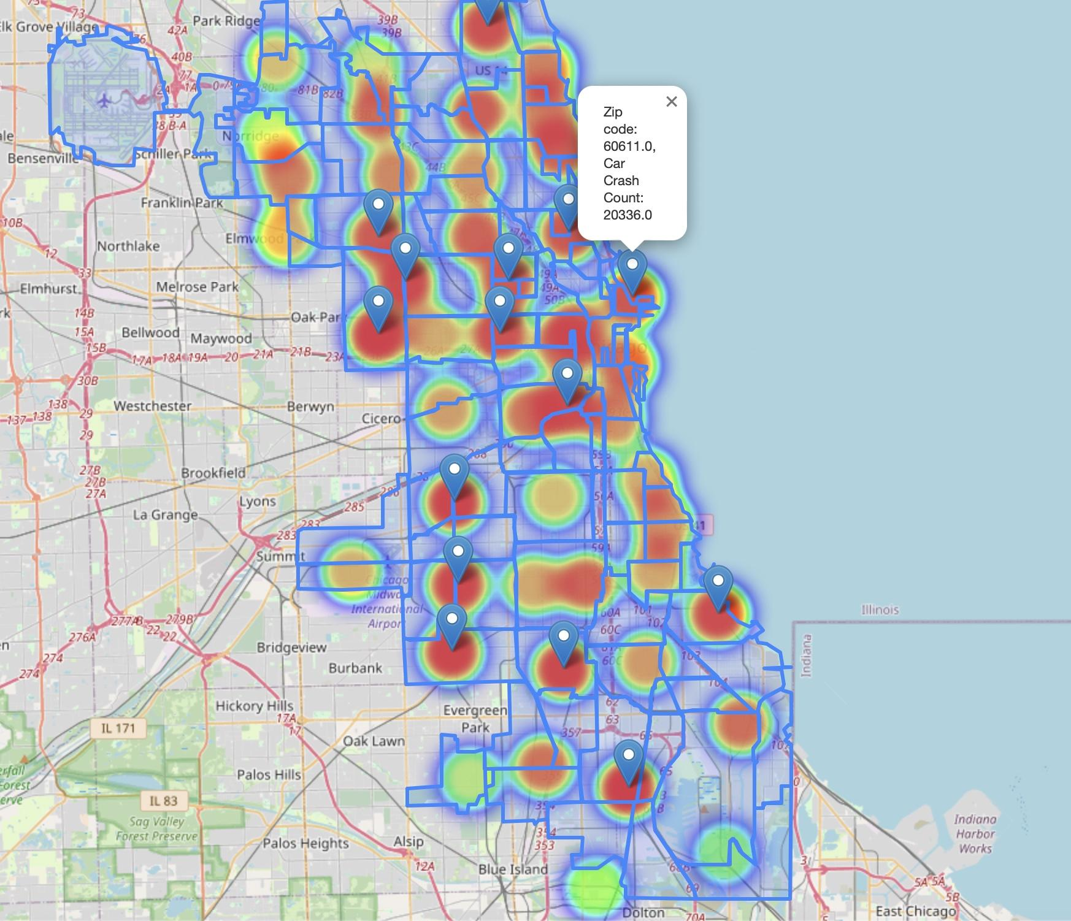
Our Teams Vision
Create a safe driving culture in Chicago
Continue to create visual models and machine learning to better identify hazard points
Update our data, and optimize our programs accuracy
Allow for more credible business decisions
Safer Roads Initiative
Establish a culture of safe driving in Chicago:
Utilize various strategies to promote safe driving practices
Collaborate w/ Government officials
Use our maps and models to allocate resources effectively to promote transportation welfare

Slide 11
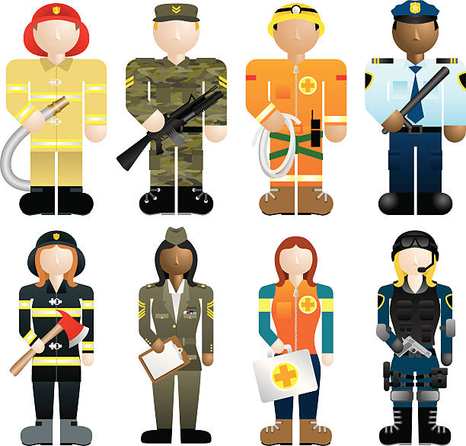


Future Research Opportunities
Our Team identified many future research opportunities:
Use models to identify locations which more emergency personnel should be located
Use Vision API with cameras to identify reckless behavior in these high risk locations
Allow GPS users to avoid high-risk areas on their route

